Slide 1
Amazon Sales Analysis
By :-
Nithish Bodakunti
Mail Id - nithishbodapunti12@gmail.com

Slide 2
The problem
Company
Context
Problem statement
Amazon, is a multinational technology company based in Seattle, Washington.
It is engaged in e-commerce, digital streaming, cloud computing, advertising, etc.
Sales Management is very important for e-commerce company to sustain in market.
To stand out in the competition it is important to manage sales to meet demands according to that region or nation.
Finding key metrics and meaningful relationship between attributes to efficiently handle sales.
By reducing costs, increasing profits and improving methods of distribution based on demand.

Slide 3
Challenges deep-dive
Challenge 1
Challenge 2
Challenge 3
Data Processing
Data needs to be cleaned and check for abnormalities like outliers. Discovering trends and arranging data as per requirements.
Data Context
Figuring out how data to be manipulated, on what basis data needs to be rearranged. To know key factors in data and understand their relationships.
Data Analysis
To improve sales of products which are not performing and to meet the demand of products that are highly performing. To know strong regions and seasonal sales.

Slide 4
Solution
Finding out nulls and outliers.
Using statistical hypothesis to fill null data.
Exploratory Analysis of data to verify hypothesis.
Detailed study of outliers, to not to miss important trends.
Rearranging data by centering data around key attributes.
Visualising data based on the trends and relations observed.
More premium subscribers

Slide 5
Implementation

Slide 6
Observing data by its attributes, data types and understand complete picture.
Analysing data based on key attributes and finding key metrics and trends.
Presenting key findings and important points to use and implement findings effectively.
Data Study
Data Processing
Data Analysis
Data Visualisation
Presenting Insights
Finding if nulls present and identifying outliers and preparing data for analysis.
Visualising trends and communicating the insights through graphs and charts for detailed understanding.

Slide 7
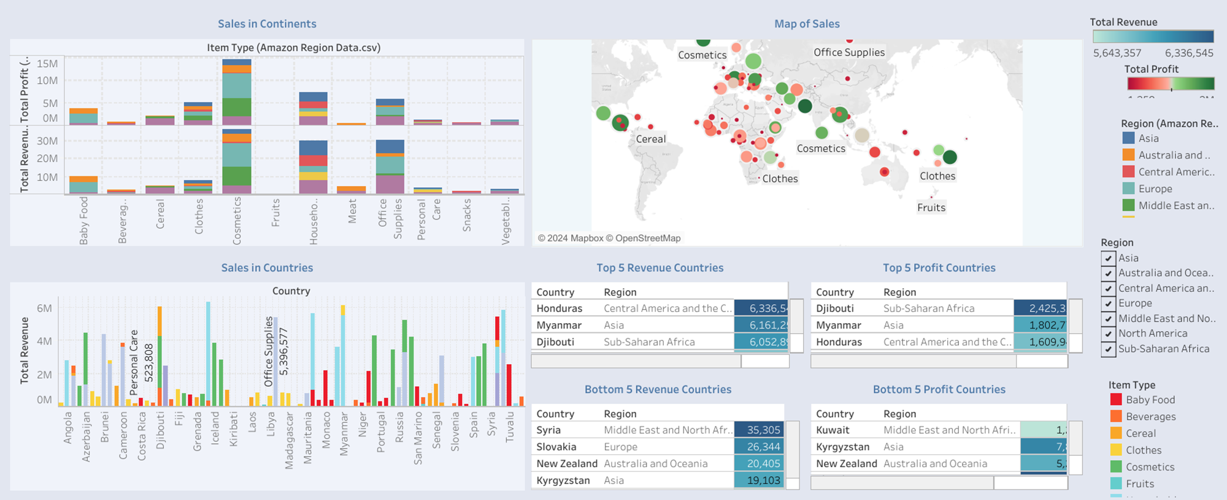
Regional Sales Dashboard
Abby Author

Slide 8
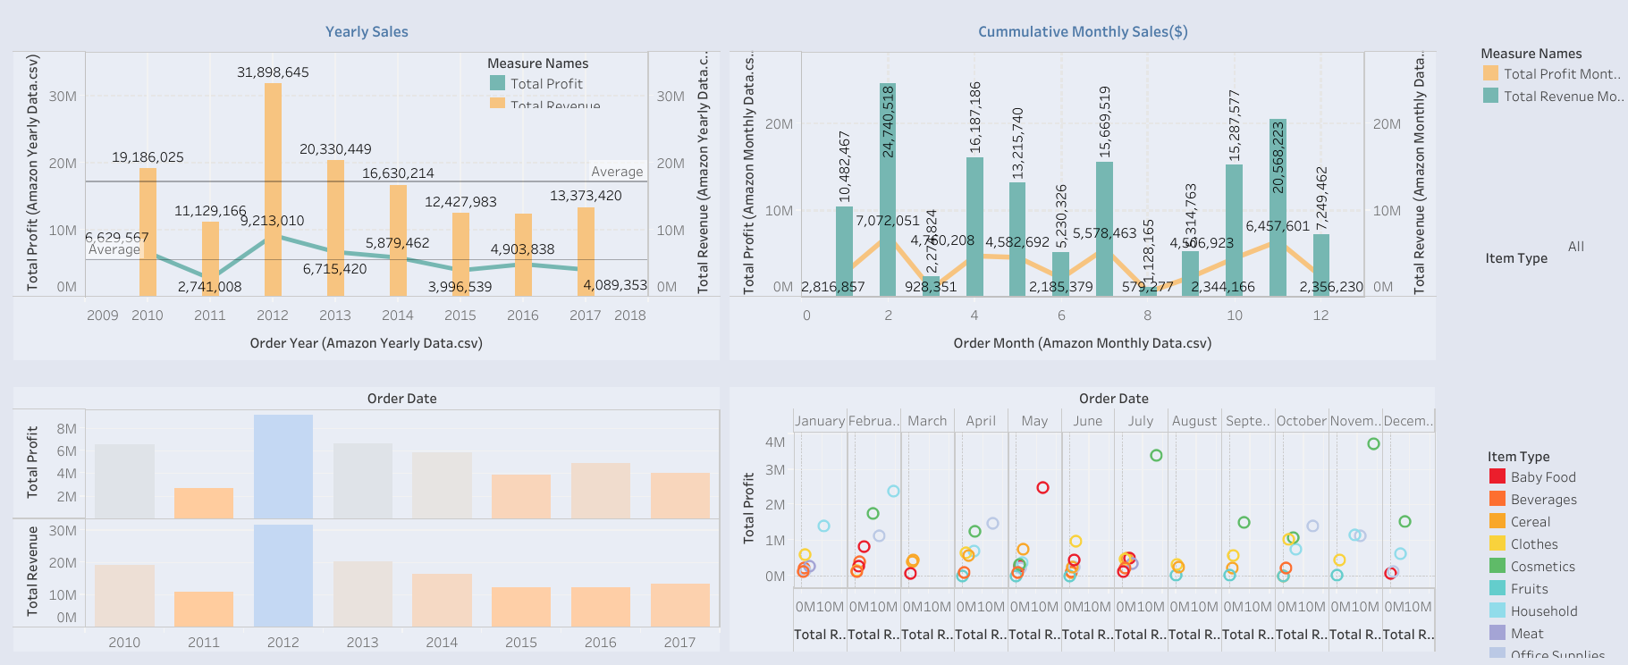
Yearly Sales Dashboard

Slide 9
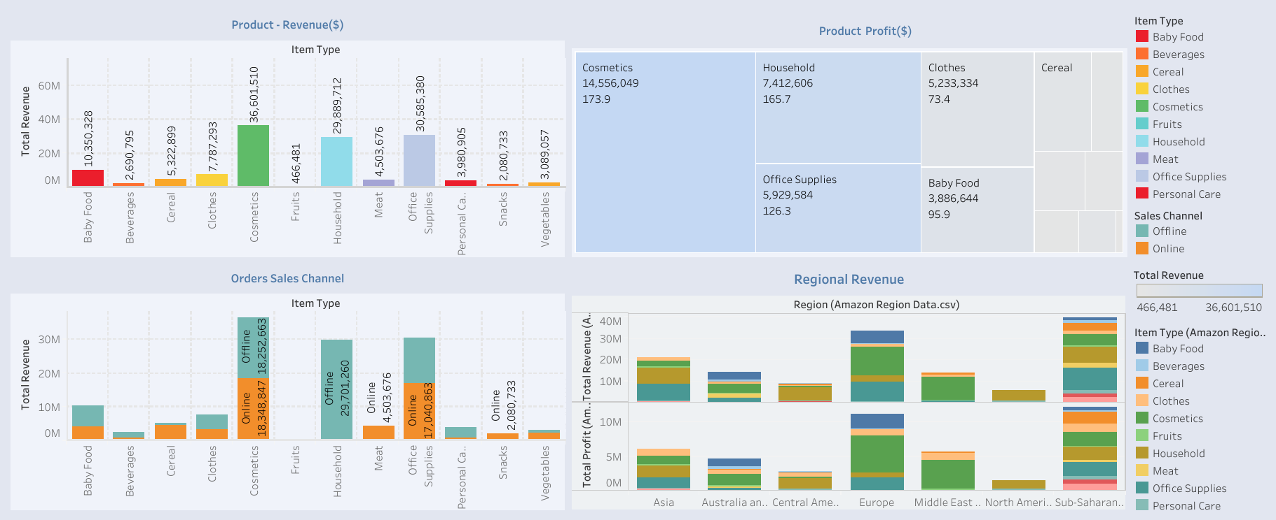
Product Sales Dashboard

Slide 10
Insights
It is found that Africa and Europe are major revenue sources and profit making regions.
It is observed that March and August sales are very low so providing deals and managing costs may help in increasing sales and cutting cost.
We find household items are sold only through offline mode, so bringing technical advances may help increasing revenue and profits in that category.
It is important to boost sales of food items.
Asia and Australia regions are potential to increase revenue by introducing different products.

